Slide 1
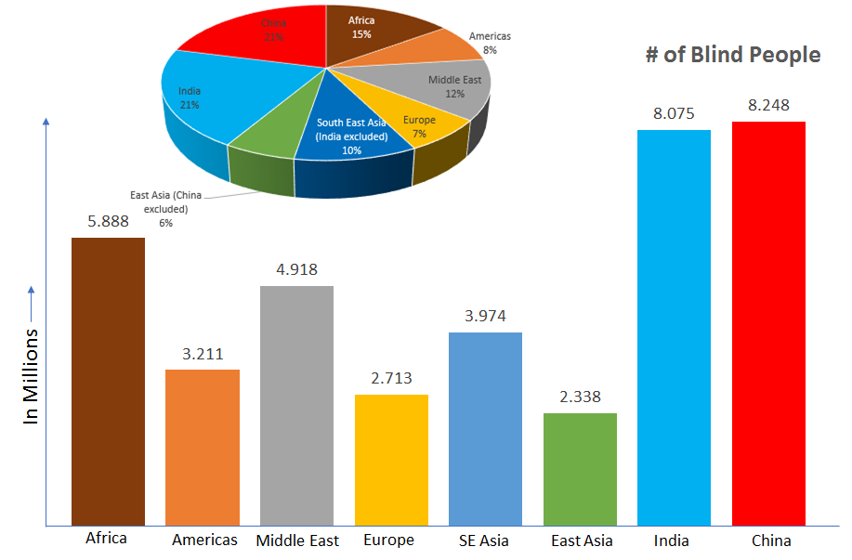
U
UNSIGHTED
There are 18.7 million blind people in India of the total population.
The major cause of blindness in India, is due to cataract formation.
It is estimated that in India 1 person in every 1000 population goes blind due to cataract alone, every year.
This was the report of India alone, on world level its 2.2 billion people.
1

Slide 2

H
HAVE
Our team Maruti worked on the problem and come up with an idea that would solve the problem of blind people.
Blind people will have the product that would change their view of seeing the world.
2

Slide 3



A
ADOPT
ADOPT our product “GOD’s Eye” especially made for blind people.
“GOD’S EYE” is a Google that work on ultrasonic technology.
Along with you can use a “SHOE” or ‘GLOVES” with the same functioning of “Googles”
3

Slide 4

C
CARRY
The person who carry the product get the alarming sound of the obstacles.
Whenever an obstacles comes in range of 1m the buzzer on “Goggles” ,”Gloves” and “Shoe” starts beeping, that will alert the blind person.
4

Slide 5

M
MARKET VALUE
Since there are more number of blind people all over the world our product will be the cheapest option for them.
Low Repairing cost as well as flexibility of getting home service.
Variety of option available to adopt, user have the choice to choose either Gloves, Shoes, Googles.
Even the production of our product take very less amount of time, when machinery involved the time will reduce more, therefore serving a large quantity with quality in less time.
5

